Slide 1


Junior/Senior Parent Night
College and Financial Aid Presentation
October 24, 2023

Slide 2



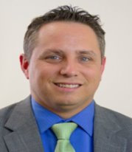
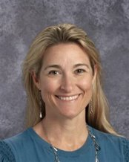
Meet your Administrative Team
Mrs. Patterson: Principal
Ms. Berry: AP 12th grade & 10th grade A-L
Mr. Woodside: AP 11th grade & 10th grade M-Z
Mr. Larson: AP Medical Magnet & 9th grade A-L
Mrs. Striblen: AP IB & 9th grade M-Z

Slide 3
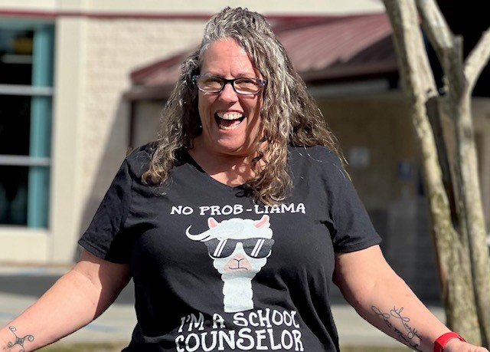
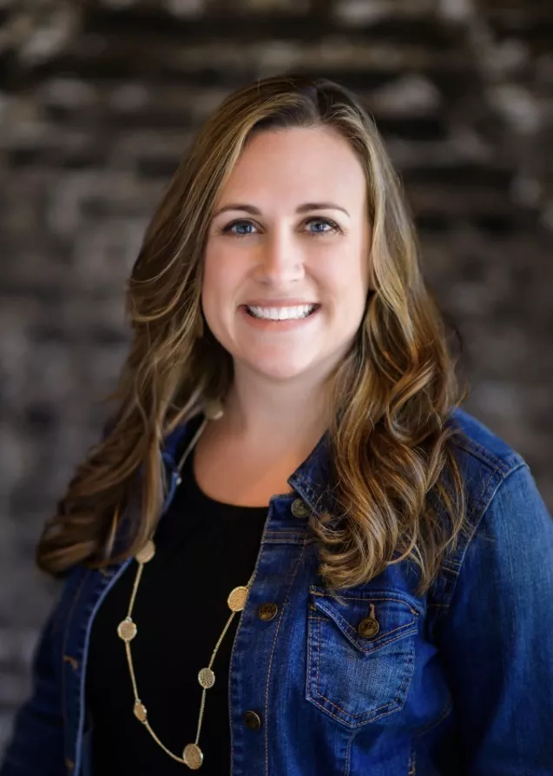



Your
School Counselors are here to help!
Program | Counselor
I.B.: | Amber Shepherd-Thompson
C.W.M.P.: | Erika Picard
University Last Names A-G | Elizabeth Ryczek
University Last Names H-O | Tim Papp
University Last Names P-Z | Amanda Madej

Slide 4


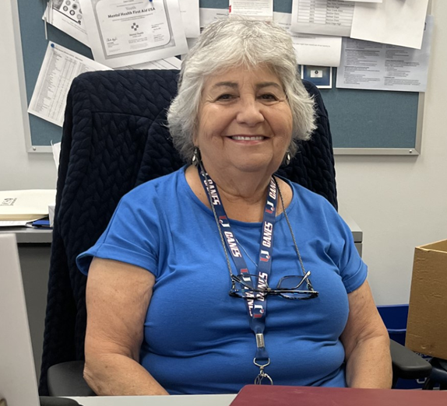
Your 11th Grade Secretaries
Ms. Marino – Medical Magnet
Ms. Marsh– IB
Ms. May – 11th Grade University

Slide 5
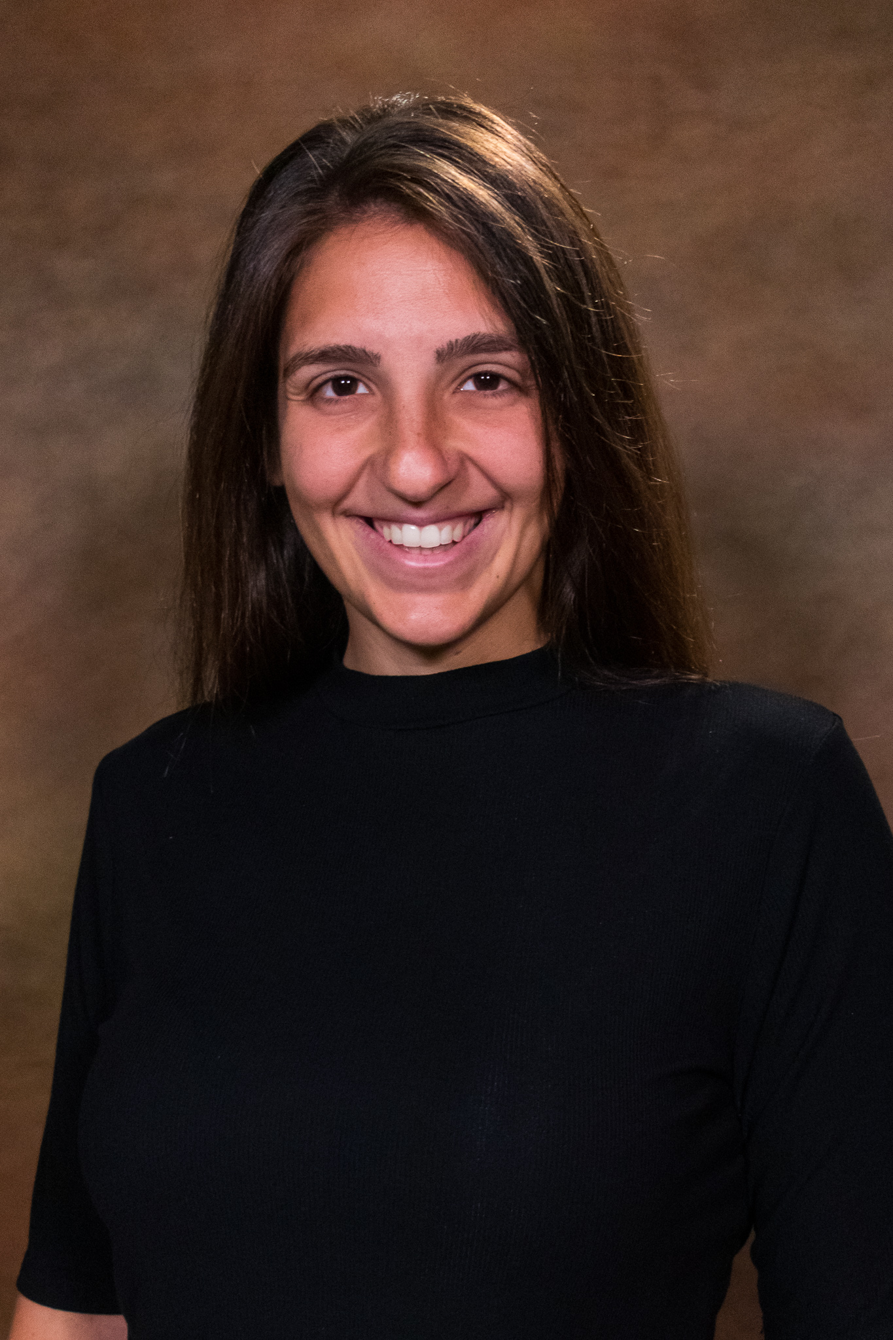
Your 12th Grade Secretaries
Ms. Marino – Medical Magnet
Ms. Marsh– IB
Ms. Garos – 12th Grade University

Slide 6


Agenda
Financial Aid, FAFSA, Bright Futures, Scholarships- Brooke Pair
Jr/Sr information
  Grad Requirements
  College Admissions
  Resources
Open
  Questions and Answers
This Photo by Unknown Author is licensed under CC BY-SA

Slide 7



Graduation Requirements

Slide 8

Graduation Requirements
Credits
  24 credits, specific subject area requirements
GPA
  2.0 unweighted cumulative GPA
Testing
  Pass FSA ELA Grade 10/FAST ELA PM3 or earn concordant
  Pass Alg 1 EOC or earn concordant

Slide 9
Testing Requirements
Pass FSA ELA Grade 10/FAST ELA PM3 (350 or higher) OR Concordant on any of following:
  ACT (Avg of 18 on Reading and English)
  SAT (480 on EBRW)
  CLT (36 on Verbal Reasoning and Grammar/Writing)
Pass Alg 1 EOC (499) OR Concordant on any of following:
  ACT (16 Math)
  SAT (420 Math)
  PSAT (430 Math)
  CLT (11 Quantitative Reasoning)

Slide 10

Graduation Requirements
English
4 credits
Math
4 credits, must include Algebra 1 (1.0) and Geometry (1.0)
Science
3 credits, must include Biology (1.0)
Social Studies
American Government (0.5) Economics with Financial Literacy (0.5)
US History (1.0) World History (1.0)
This Photo by Unknown Author is licensed under CC BY

Slide 11

Graduation Requirements
Performing/Fine Arts/Career Techincal Education
1 credit in fine/performing or approved CTE
HOPE (Health Opportunities Through Physical Education)

Slide 12
IB Graduation Requirements
English
  4 credits
Math
  4 credits, must include Algebra 1 (1.0) and Geometry (1.0)
Science
  4 credits, must include Biology (1.0)
World Lang.
  4 credits
Social Studies
  US History (1.0)
  World History (1.0)
  History of the Americas(1.0)
  Contemporary History (1.0_
CAS
EE
TOK

Slide 13

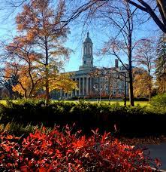
4 Year College/University Requirements
In addition to HS Grad requirements you must take:
Algebra 2
2 or 3 years of foreign language (consecutive, same language)
Recommendation:
take foreign language throughout HS
take advanced coursework (AP, DE, AICE, Honors)
take additional math and science courses (as advanced as you can)

Slide 14


This Photo by Unknown Author is licensed under CC BY-SA-NC
Online registration
https://collegereadiness.collegeboard.org/sat
Cost is $60
Additional fee for late registration
SAT
2 Sections: Evidence Based Reading & Writing and Math
Test code center # is 100254
College Athletes: Code 9999 on test to send to NCAA
Will offer a FREE SAT School Day test for ALL Juniors in March; Seniors took on Oct 11th

Slide 15

Online registration
www.actstudent.org
Cost is $60 for the ACT (No Writing)
$85.00 for the ACT Plus Writing
Additional fee for late registration
$16 for each additional score report (first 4 colleges included)
College Athletes: Code 9999 on test to send to NCAA
Test code center # is 100254.

Slide 16
SAT vs ACT
Constant changes right now on test dates and testing policies!
More and More colleges are going test optional
Some say ACT caters a bit towards general academic strengths
SAT gives slightly more time per question than ACT.
Neither penalizes for wrong answers, so you should always give your best guess!
Neither measure intelligence – just how well you do at taking this company’s test

Slide 17
SAT vs ACT
Sign ups for both are done through the testing agency.
Fee Waivers are available for students on free/reduced lunch: 2 waivers each lifetime
Test Blind: these schools won’t look at test scores AT ALL.
Test Optional: consider test scores. Check the middle 50% range of scores… if you scored in this range or higher, then submit.
Superscoring: taking the highest score of each section to total your highest composite scores

Slide 18

College admissions

Slide 19
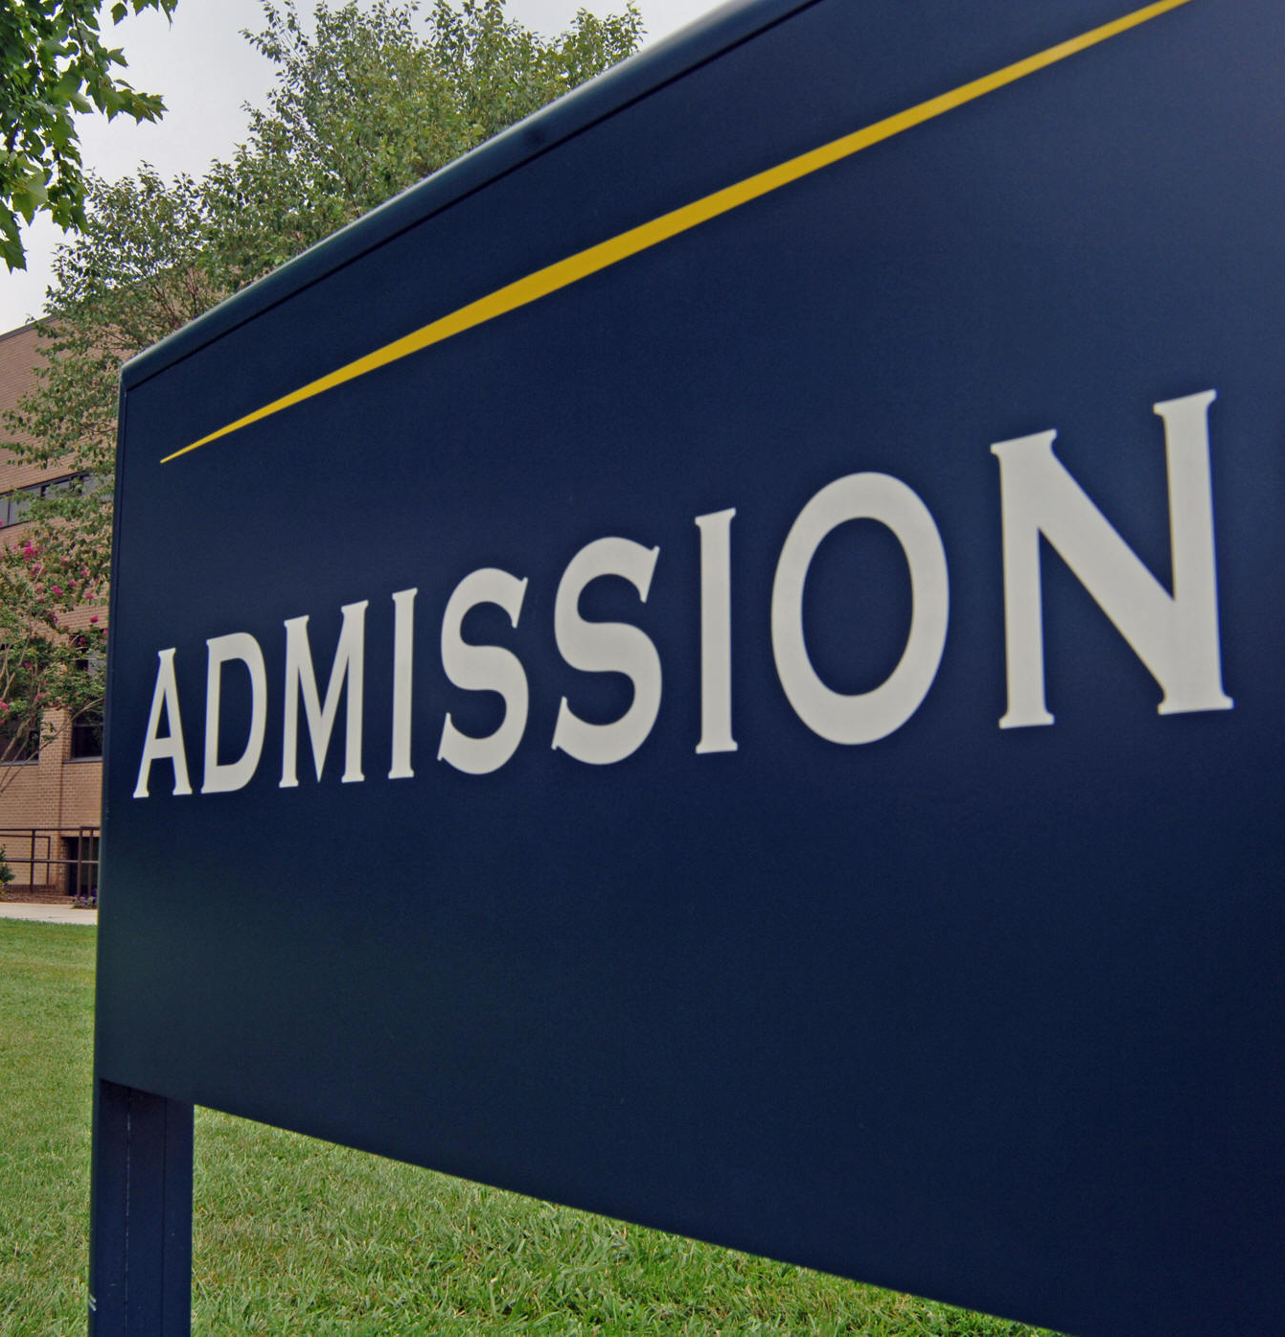
College Admissions
What should your child be doing right now?
  APPLYING TO COLLEGES- if senior/early grad
  Researching colleges, majors, programs of interest
  Visit colleges websites to determine admission requirements/deadlines
  Visiting college campuses (2 days excused w/ proper documentation)
  Attending college/career fairs to speak to admissions representatives
  Ask teachers and counselor for recommendation letter, if required
  Send SAT/ACT scores, AP scores, official transcripts once submit application

Slide 20
College Research - Where do you want to go?
NAVIANCE!
Florida Shines - www.floridashines.org
Big Future Collegeboard - www.bigfuture.collegeboard.org
eCampus Tours - ecampustours.com
Admittedly - admitted.ly
Cappex - cappex.com
Chegg - chegg.com
College Raptor- collegeraptor.com
Is this college a good fit for me?
  Do they have my major?
  SAT?
  ACT?
  GPA?
  LOCATION?
  Is the price tag realistic?
  What is their 4-year graduation rate?
  What is their avg freshman retention rate?
  Are there options for study abroad?
  Are their students employed upon graduation?

Slide 21
College Admissions-Applications
There are various ways to apply
All students must connect Naviance to Common App
If student not applying through Common App they still MUST add college to Naviance college list

Slide 22

Application to do list
Submit an application online
  If using Common App – have to connect CA to NAVIANCE
Be aware of application deadlines
    Early Decision
    Early Action /Early Action Restrictive
    Regular decision
Send your SAT/ACT scores through the testing agency
Request/Send Transcripts
Are letters of recommendation needed?
  Ask a minimum of 3 weeks before the deadline
SSAR/SPARK

Slide 23

Types of Decisions
Early Decision
a binding application to one college, non-refundable deposit, deadlines as early as October 15/November 1
Early Action
not binding, hear back from college sooner, must decide by May 1
Priority Decision
not binding, comes before regular decision, may give you priority decision on housing, scholarships
Regular Decision
deadline usually between November - May
Rolling Admission
students are accepted all year long

Slide 24

SSAR
Self-reported Student Academic Record
Participating colleges/universities:
Flagler College
Florida A & M University
Florida Atlantic University
Florida Polytechnic University
Florida State University
New College of Florida
University of North Florida
University of Florida
University of South Florida
University of West Florida
https://ssar.selfreportedtranscript.com/Login.aspx
FSU has the best help page for anything and everything to do with the SSAR:
https://admissions.fsu.edu/first-year/ssar/

Slide 25
Letters of Recommendation
Who to ask
Min 3 week notice
Invite them to NAVIANCE, etc
FERPA - waive your rights - what does this mean?
Resume

Slide 26
FERPA
Under the terms of the Family Educational Rights and Privacy Act (FERPA), you can review letters of recommendation and use accompanying forms after you enroll at a postsecondary institution and only if that institution saves the documents post-enrollment.
Why should you consider waiving your right of access?
Waiving your right lets colleges know that you will never try to read your recommendations.
That in turn reassures colleges that your recommenders have provided support that is candid and truthful.

Slide 27

transcripts
What is on my transcript?
Can submit application prior to sending transcripts
Hard Copy - see Ms. Garos- $1
  (garost@pcsb.org)
Naviance (common app) – counselor does it & Free
Through applications – counselor does it & free
SSAR/SPARK – YOU DO IT & FREE

Slide 28
timeline
take a Fall SAT/ACT if needed for test scores for Nov/Jan deadlines
Attend any info workshops or meetings held at school
Narrow down college list
Begin applying to colleges
Stay organized with deadlines
Request transcripts and LORs be sent through Naviance
FAFSA,
Bright Futures,
Pinellas Ed Foundation
Open now, Dec 1 (FAFSA)
Attend any financial aid workshops offered by district or local universities
Send test scores through testing agencies
Make a college decision and secure your spot by paying your deposit

Slide 29
College Dates & Deadlines
Sun | Mon | Tue | Wed | Thu | Fri | Sat
 |  |  | 1 | 2 | 3 | 4
5 | 6 | 7 | 8 | 9 | 10 | 11
12 | 13 | 14 | 15 | 16 | 17 | 18
19 | 20 | 21 | 22 | 23 | 24 | 25
26 | 27 | 28 | 28 | 30
Oct 15 | Some Early Actions
Nov 1 | Major Deadlines for ED/EA
Nov 15 | Deadlines
Dec | More Deadlines
Jan 1-15 | Regular Deadlines
29

Slide 30
College Admissions Resources
College Application Week
  October 23-27-Counselors will be available in career lab for assistance with applications, scholarship applications including Bright Futures Application and Pinellas Education Foundation Scholarship, SSAR, reviewing essays, etc.
  Apply SPC FREE application drive-Oct 25th during Coll App Week Periods 6 and 7
    SPC representatives will be in career lab to aid all those filling out the application
  Pinellas Technical College will be in career lab Oct 25th periods 3 and 4
Apply Yourself Florida! Student Guide

Slide 31
Scholarships and resources

Slide 32
Scholarships
www.pcsb.org/financialaid
  Scholarships updated monthly
www.cappex.com
www.fastweb.com
www.scholarships.com
www.tuitionfundingsources.com
www.chegg.com/scholarships
https://bigfuture.collegeboard.org/scholarship-search
www.floridastudentfinancialaidsg.org
www.mycollgedollars.com
www.scholarships.com
www.scholarshipsexperts.com
https://www.collegeraptor.com/college-guide/category/scholarships/
www.raise.me
www.highfivescholarships.com
www.Collegescholarships.org
www.unigo.com
https://myscholly.com/
https://www.niche.com/colleges/scholarships/
https://www.salliemae.com/college-planning/tools/scholarship-search/

Slide 33
FOCUS/Portal Resources
Clever
Access all programs/resources
Including virtual textbooks, programs used in class, Canvas, Naviance, Office, etc.
Naviance
customizable planning portal for students and families including self-discovery assessments, goal-setting, college research tools, and career exploration resources.
Office 365
Access excel, word, powerpoint, files
Access school email through outlook (r2.d2@pcsb.org)

Slide 34

Naviance
Naviance is a customizable planning portal for students and families including self-discovery assessments, goal-setting, college research tools, and career exploration resources.
On Naviance, you can take a career interest inventory, complete a resume, search for colleges and explore a variety of post-secondary options.
Introductory Naviance video: https://www.screencast.com/t/tbcYt9eUkKg
Logging into Naviance
  Log into Clever and select the Naviance icon. You can also type “Naviance” into the search bar.
  Once you are in Naviance, scroll down to see your “Important To Dos and Tasks” and begin working on those. You can also click on “Planner” in the top tool bar and select “Tasks” to see what is required for you to work on.

Slide 35
Naviance Tasks-12th grade
1st semester-eDocs Orientation Survey
2nd semester-Senior Survey
Students will confirm moved final list of colleges from Colleges I’m Thinking About into College I’m Applying to list, review eDocs orientation and match Common App to Naviance
Videos for students
Common App Registration and Account Matching: https://www.screencast.com/t/wJlv73VNdeA
Building a List of Colleges I’m Applying To: https://www.screencast.com/t/jp4DehOsrA
Editing Colleges I’m Applying To: https://www.screencast.com/t/oUbZbG8qSuR
Request Transcripts in Naviance Student: https://www.screencast.com/t/LMtSIif3e1
Requesting a Final Transcript: https://www.screencast.com/t/yFlgLhUy
Letter of Recommendation Requests: https://www.screencast.com/t/X4WK0KNZN

Slide 36
Naviance Tasks- 11th grade
1st semester-My Post-Secondary Plan
Students learn the various ways to pay their way through college, including financial aid at the state and federal level, scholarships, grants, loans, work-study, etc. Students learn how “real” college students have paid for college and create a plan for how they might pay for college based on what they learned and their My Post-Secondary Plan activity sheet.
2nd semester-Game Plan Survey
Students move final list of colleges to Colleges I’m Applying to list; learn how to request transcript, complete survey

Slide 37

Resources
Homework Help for Math
Tuesday All Math 19-103 2:05-4:05
Wednesday Alg 1 19-122 2:00-2:40
Friday Alg 1 & 2, MCA and MCLA 19-232 2:00-3:00
Khan Academy- video tutorials all subject areas
https://www.khanacademy.org/
Homework Help Line
727-547-7223
Monday – Thursday 5:00pm-8:00pm
Pinellas ecounselor
Ask counselor questions during off hours: ecounselor@pcsb.org

Slide 38
College and career center
https://padlet.com/thompsonkir/wo42a9uss2slrtgq
The college and Career Center supports students and families to access resources, explore opportunities and work collaboratively on:
  Career pathway and major exploration
  College exploration and match
  Application development and submission
  SAT/ACT preparation resources
  College fair and admission events
  Financial and scholarship planning
  Essay preparation and review
Ms. Kirby Pratt Room 1-154 PrattKIR@pcsb.org

Slide 39

Padlet
University student Padlet
https://padlet.com/madeja/university-student-padlet-wci6imj5weyvz2pv
IB Senior Padlet
https://padlet.com/shepherda5/senior-info-t90ztc16h0jqe5fq
CWMP Padlet
https://padlet.com/marinojay/center-for-wellness-and-medical-professions-62s0almv2dqm7at

